Slide 1

Construct a knowledge Graph with from Text Data
Machine Learning CSC-8515
Name : Tanjina Alam
Villanova University

Slide 2

Contents
Introduction
Problem and goal
What is a knowledge graph
How to represent knowledge in a graph
Construct a Knowledge graph
Sentence Segmentation
Entities Extraction
Extract Relations
Build a Knowledge Graph from Text Data
External database enrichment
Knowledge graph and Its applications
Knowledge graph as machine learning data input
Challenges Faced
References

Slide 3
Introduction
Knowledge graph is one of the most interesting and fascinating concept in machine learning.
In this presentation I am going to introduce you with knowledge graph, how it is implemented.
The full process of generating the knowledge graph consists of three parts
Sentence Segmentation
Entities Extraction
Relations Extraction
Knowledge graph and its applications
Knowledge graph and Machine learning

Slide 4
Problem and Goals
Today we will extract the data from the one text data set and try to visualize the relationship between them. We will export the data set from Wikipedia.
End of this presentation our goal is to understand
Get some text and extract relevant information
Create a knowledge graph
Vectorize knowledge graphs
Know how to apply machine learning into this knowledge graph

Slide 5
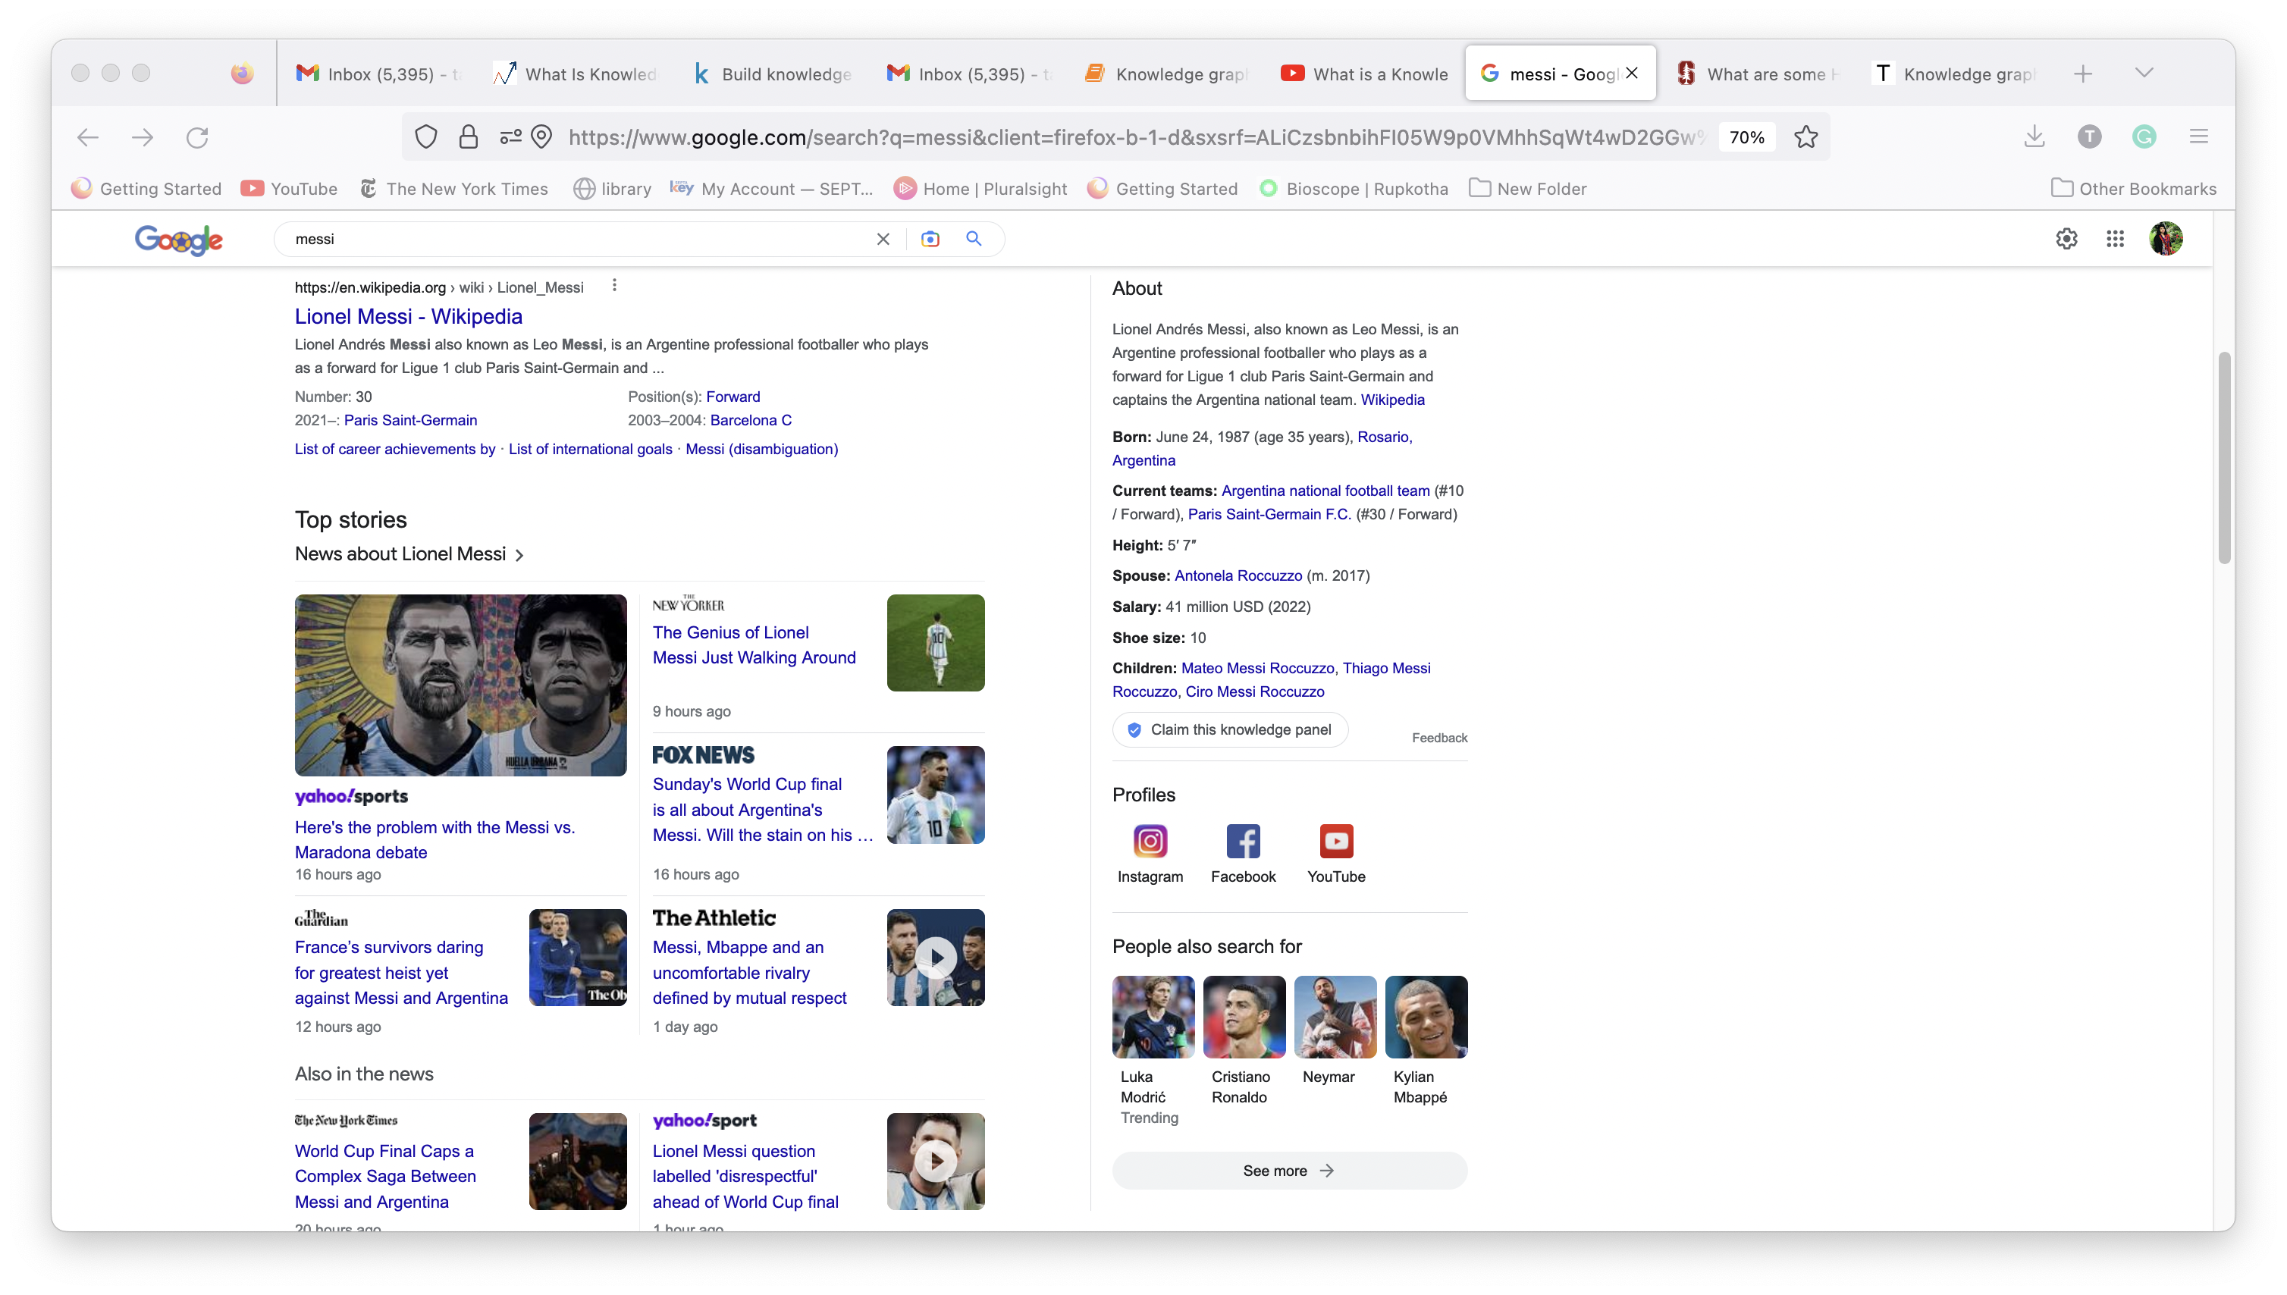
What is a knowledge graph
Knowledge graph represents a collection of interlinked descriptions of entities objects events or concepts. Knowledge graphs put data into context via linking and semantic meta data and this way provide a framework for data integration, analytics and sharing.
In machine learning , common use cases are around adding identifiers and descriptions to data of various modalities to enable sense-making, integration, and explainable analysis. In AI, knowledge graphs complement machine learning techniques to:
reduce the need of large, labelled datasets;
facilitate transfer learning and explain ability;
Encode domain, task and application knowledge that would be costly to learn from data alone.

Slide 6
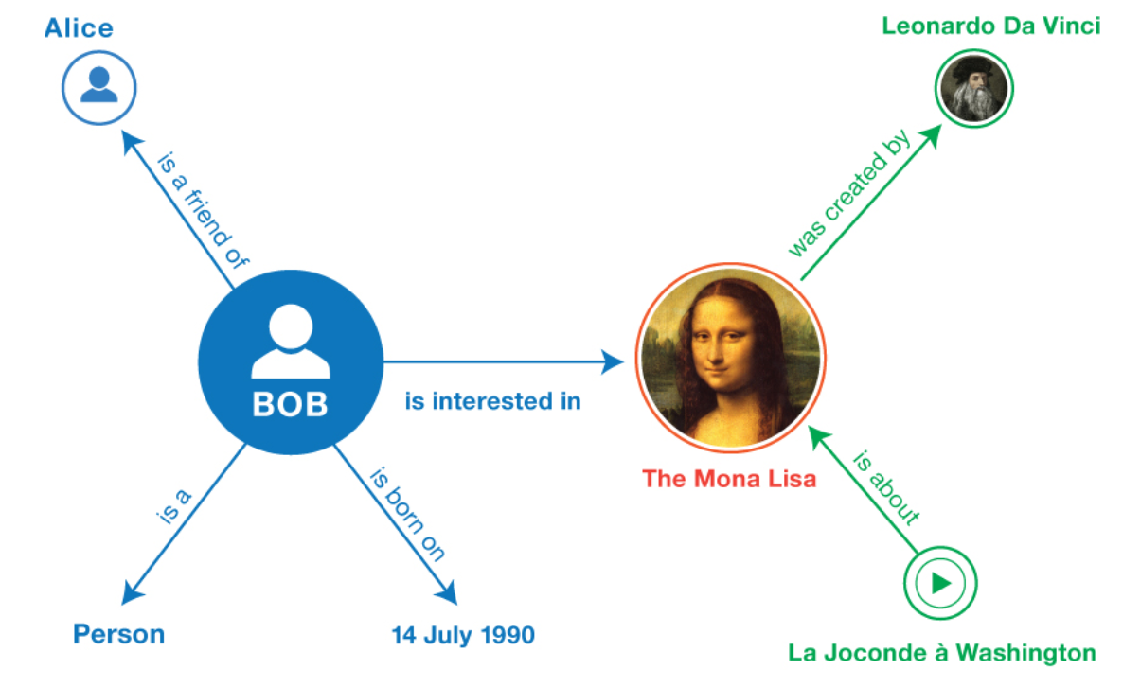
How to represent knowledge in a graph
A knowledge graph, also known as a semantic network, represents a network of real-world entities—i.e. objects, events, situations, or concepts—and illustrates the relationship between them. This information is usually stored in a graph database and visualized as a graph structure, prompting the term knowledge “graph.”
A knowledge graph is made up of three main components: nodes, edges, and labels. Any object, place, or person can be a node. An edge defines the relationship between the nodes.
A simple KG example is shown. One example of fact could be <BoB, is_interested_in, The_Mona_Lisa>. You can see the KG is nothing but a collection of multiple such facts.

Slide 7
Construct a Knowledge Graph and Use of NLP
We will construct a knowledge graph from a text file Which is scraped from Wikipedia data to discover structured information and relationships.
Manually building a knowledge graph is not scalable. Nobody is going to go through thousands of documents and extract all the entities and the relations between them!
Machines do not understand natural language. This is where Natural Language Processing (NLP) comes into the picture.
To build a knowledge graph from the text, it is important to make our machine understand natural language. This can be done by using NLP techniques such as sentence segmentation, dependency parsing, parts of speech tagging, and entity recognition

Slide 8
Construct a Knowledge graph
We will build a knowledge graph from scratch by using the text from a set of movies and films related to Wikipedia articles. We will use a data set which is already extracted around 4,300 sentences from over 500 Wikipedia articles. Each of these sentences contains exactly two entities – one subject and one object.
Lets go to the Jupyter notebook for code and more details.

Slide 9
Knowledge graph and Its applications
Retail: Knowledge graphs have been for up-sell and cross-sell strategies, recommending products based on individual purchase behavior and popular purchase trends across demographic groups.
Healthcare: Knowledge graphs are also benefiting the healthcare industry by organizing and categorizing relationships within medical research. This information assists providers by validating diagnoses and identifying treatment plans based on individual needs.
Life Sciences: AstraZeneca built a biomedical knowledge graph with TypeDB to predict new disease targets for drug discovery. They ingest heterogeneous biomedical data such as genes, proteins, compounds, and diseases.

Slide 10
Knowledge graph as machine learning data input
Machine Learning can support the creation of relations using classification, but also the definition of the classes. For instance, Natural Language Processing of documents can model topics and recognize named-entities. With their statistical representation, a human can then make data-informed decisions about which elements should constitute new types of relations. These then become the labels for the classification.

Slide 11

Challenges and future implementation
Challenges :
Jupyter notebook got slower. We could use Google-colab.
Future improvement : We restricted ourselves to use sentences with exactly 2 entities. Even then we were able to build quite informative knowledge graphs. We could extract more future implementations with more entities.
There are many free Open-source knowledge graphs tools we could use that in future.

Slide 12
References
Construct a biomedical knowledge graph with NLP | by Tomaz Bratanic | Towards Data Science
From Text to Knowledge: The Information Extraction Pipeline | by Tomaz Bratanic | Towards Data Science
Cetoli, A. (2020). Exploring the zero-shot limit of FewRel. In Proceedings of the 28th International Conference on Computational Linguistics (pp. 1447–1451). International Committee on Computational Linguistics.
https://www.kaggle.com/code/nageshsingh/build-knowledge-graph-using-python/notebook
https://towardsdatascience.com/knowledge-graphs-and-machine-learning-3939b504c7bc
https://towardsdatascience.com/a-guide-to-the-knowledge-graphs-bfb5c40272f1
https://neo4j.com/blog/future-ai-machine-learning-knowledge-graphs/
https://www.turing.ac.uk/research/interest-groups/knowledge-graphs
https://www.analyticsvidhya.com/blog/2019/10/how-to-build-knowledge-graph-text-using-spacy/
https://www.youtube.com/watch?v=5ejrG3hX2T8
https://www.ibm.com/cloud/learn/knowledge-graph
https://blog.vaticle.com/what-is-a-knowledge-graph-5234363bf7f5
https://neptune.ai/blog/web-scraping-and-knowledge-graphs-machine-learning
https://web.stanford.edu/~vinayc/kg/notes/What_Are_Some_High_Value_Use_Cases_Of_Knowledge_Graphs.html

